Slide 1
Squeeze-and-excitation networks
Hu, J., Shen, Li., Sun, G. (2017)
Sahand sabour 2020280401
Tee Kah Hui 2020280402
2021年3月31日

Slide 2
Introduction
Convolutional Neural Networks (CNNs) have been proven to be effective for different visual tasks.
CNNs are able to:
Fuse spatial and channel-wise information in local receptive fields.
Capture hierachical patterns with global receptive fields.
Previous work concentrates on reducing the model complexity, while the authors of this work want to improve CNNs by proposing a new unit.

Slide 3
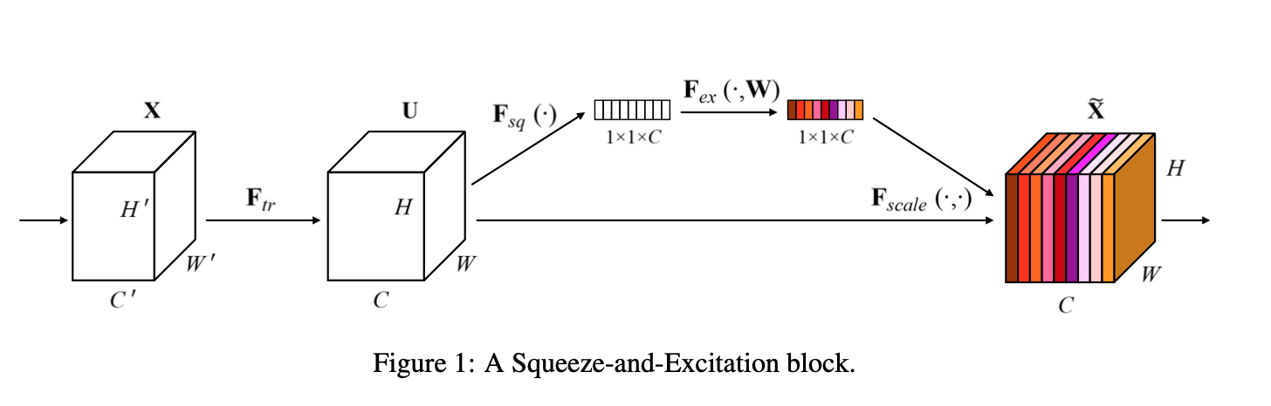
Squeeze-and-excitation
Purpose of this unit:
Improve the network's representational power by modelling the interdependencies between the channels and convolutional features.

Slide 4
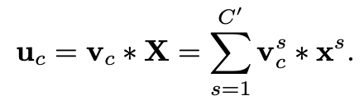
Squeeze-and-excitation
Formulation
Let F_{tr}, V and U be a convolutional operator, learned set of filter kernels and outputs of F_{tr} respectively.

Slide 5
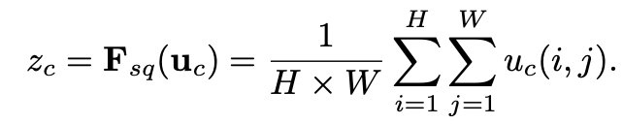
Squeeze
Formulation:
Use global average pooling to exploit contextual information outside of the local receptive field. This is done by shrinking U through spacial dimensions HxW

Slide 6

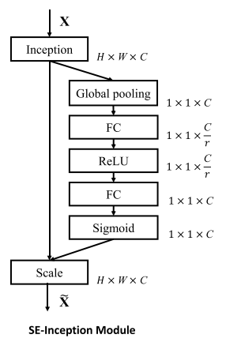

Excitation
Aims to capture channel-wise dependencies.
Excitation function must be
Capable of learning non-linear interactions between channels.
Learn a non-mutually-exclusive relationship.
Gating mechanism with sigmoid activation, ReLU activation and 2 FC layers.
Final output is obtained by rescaling feature map U.

Slide 7
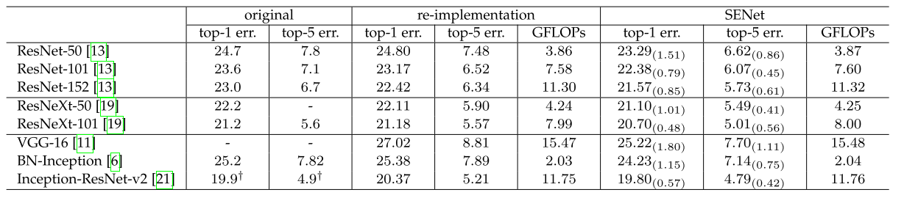
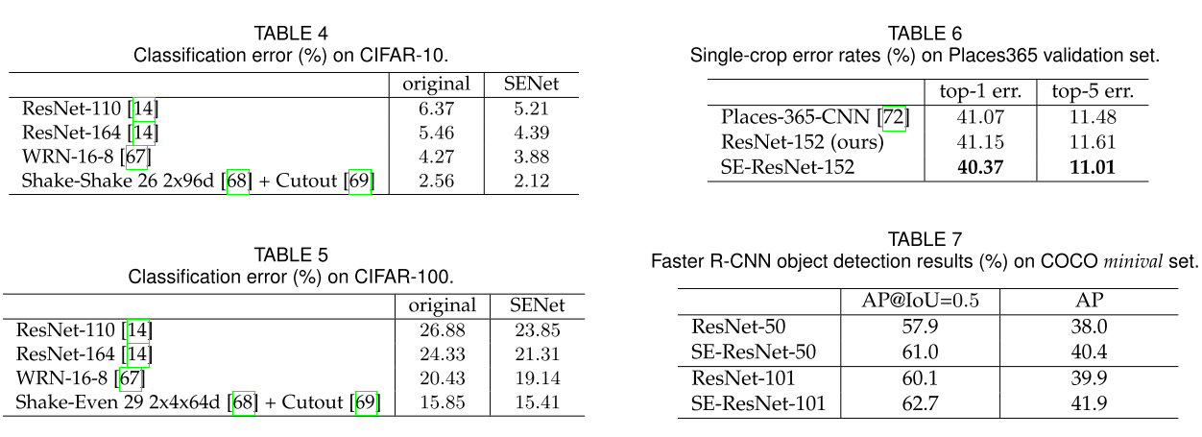
Results on imagenet
Single-crop error rates (%) on the ImageNet validation set and complexity comparisons.

Slide 8
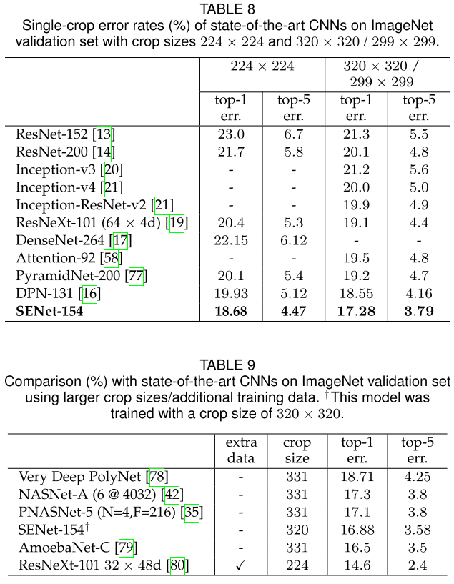
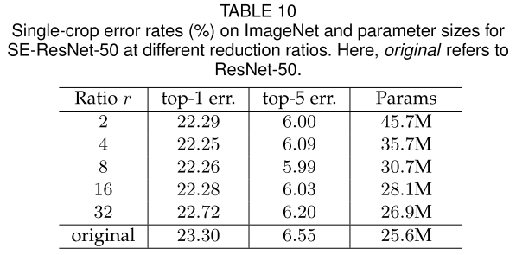
Results on imagenet

Slide 9
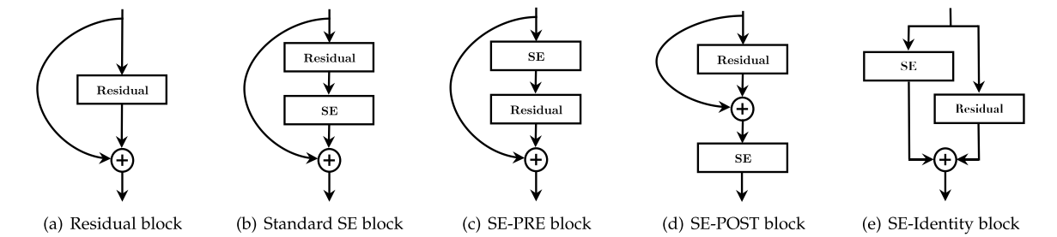
Ablation study & Role of SE blocks
Authors performed ablation study on a few aspects.
Reduction ratio
Squeeze operator
Excitation operator
Different stages
Besides, the authors also examined the importance of SE blocks.
Squeeze – global information has significant influence on model performance.
Excitation – Earlier layer has similar distribution, then become class specific at later stages, and last stage has activation of one.

Slide 10
Thank you for listening

